Slide 1
Data Driven Analytics
Name: Hridhthik TP
Mentor: Jaya Pandey

Slide 2
Introduction
Data-Driven Decision Making: Leveraging insights from car sales data to support strategic business decisions.
Comprehensive Analysis: Focusing on multiple business areas, including customer management, operations, product development, and marketing.
Industry Context: Competitive automotive industry demands actionable insights for sustained growth.
Technology: Utilizing MySQL for database analysis and efficient data handling.

Slide 3
Objective
Customer Behavior and Relationship Management: Understanding customer preferences and purchasing patterns to enhance customer engagement and satisfaction.
Operational Efficiency and Cost Optimization: Identifying areas to streamline processes and reduce costs within operations and procurement
.
Product Development: Analyzing product performance and customer feedback to guide new product innovation and development strategies.
Marketing and Sales Strategies: Evaluating the effectiveness of marketing campaigns and sales initiatives to boost revenue and market share.
Inventory Management: Optimizing inventory levels to reduce holding costs while meeting customer demand effectively.

Slide 4
Business related questions
Top 10 customers by credit limit.
The query fetches the names and credit limits of the 10 customers who have the highest credit limits, allowing you to identify the top customers in terms of available credit.
Average credit limit for customers in each country.
This query calculates the average credit limit for customers in each country, grouping the data by country. It helps to compare the average credit limits of customers across different countries.

Slide 5
Number of customers in each state.
The query returns the number of customers for each state, helping to see the distribution of customers across different states. Each row in the result represents a state and shows how many customers belong to that state.
Total sales for each customer.
The query returns a list of customers and their total sales, showing how much revenue each customer has generated. The results are sorted so that the customer with the highest total sales appears at the top. This allows you to identify the most valuable customers in terms of sales.

Slide 6
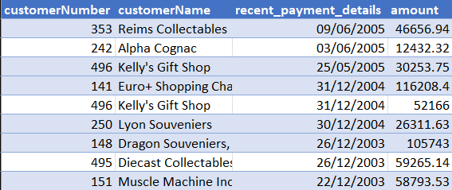
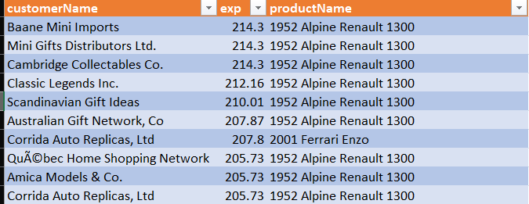
Customer information with their most recent payment details.
This query retrieves each customer's most recent payment date and the corresponding payment amount, grouped by customer and payment amount. It helps track the latest payment activity for each customer.
The names of all customers who have placed an order for the most expensive product.
This query finds the customer who has purchased the most expensive product, retrieving their name, the maximum price of that product, and the product's name . It groups the results by customer name and product name, then orders by price in descending order, limiting the result to the top entry.

Slide 7
Count the number of employees working in each office.
This query counts the number of employees in each office and sorts the results in descending order, showing which office has the most employees.
Offices with less than a certain number of employees.
The query returns the office codes of offices that have fewer than five employees, helping to identify smaller offices within the organization.

Slide 8
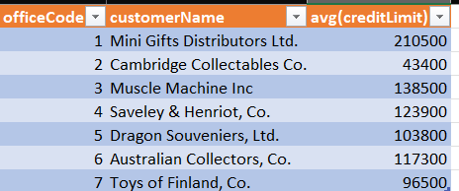
The most profitable office based on total sales.
This information is valuable for evaluating office performance and understanding sales distribution across different locations.
The average credit limit for customers in each office.
The query returns a list of office codes along with customer names and their average credit limits. This provides insight into the credit limits of customers associated with different offices, useful for analyzing customer financial profiles across various locations

Slide 9
The number of offices in each country.
The query returns the number of offices in each country, helping to understand the distribution of offices across different countries.
The number of products in each product line.
The query returns a list of product lines along with the number of products in each line, sorted to highlight the product lines with the highest counts. This helps identify which product lines are more extensive or potentially more significant in the inventory.

Slide 10
The product line with the highest average product price.
This query calculates the average price of products for each product line and sorts the results in descending order, highlighting the product lines with the highest average prices.
Products with a price above or below a certain amount (MSRP should be between 50-and 100).
The query returns a list of products that have a suggested retail price between $50 and $100, providing insights into mid-range priced products available in the inventory.

Slide 11
The total sales amount for each product line.
The query returns a list of product lines along with their total sales figures, sorted to highlight the most profitable product lines . This information is useful for evaluating sales performance and identifying which product lines generate the most revenue.
Total sales for each product.
The query returns a list of products along with their total sales figures, indicating how much revenue each product has generated. This information is valuable for assessing product performance and understanding sales distribution across the inventory.

Slide 12

Top selling products based on total quantity ordered using a stored procedure. The procedure should accept an input parameter to specify the number of top-selling products to retrieve.
When the procedure is called, it returns the product codes and names of the two products that have the highest total quantities ordered. This information is valuable for sales analysis, inventory management, and understanding customer preferences regarding popular products.
The names of all products that have been ordered by more than 10 customers.
The query returns a list of product names that have been ordered by more than 10 different customers. This indicates popular products that attract a larger customer base, which can be valuable for sales analysis, inventory planning, and marketing strategies.

Slide 13
Count the number of employees holding each job title.
This query counts the number of employees for each job title in the employees table. It groups the employees by their job titles and then displays the count of employees for each title, ordered from the highest to the lowest number of employees. The result helps to understand how many employees hold each job title and which job titles are more or less common within the organization.
The most profitable sales representative based on total sales.
This query sums the total sales for each sales representative by multiplying quantity Ordered by price Each from the order details table. It groups the results by SalesRepEmployeeNumber and orders them in descending order of total sales. This allows for easy identification of the highest-performing sales representatives.

Slide 14
The names of all employees who have sold more than the average sales amount for their office.
This query calculates the total and average sales for each employee by summing and averaging the product of quantity Ordered and price Each. It groups the results by the employee's full name and filters to include only those employees whose total sales exceed their average sales. This identifies high-performing employees in terms of sales.
The average order amount for each customer.
This query computes the average order amount for each customer by multiplying quantity Ordered by price Each. It joins the customers, orders, and order details tables, grouping the results by customer Number to provide insights into customer spending patterns.

Slide 15
The number of orders placed in each month.
This query counts the number of orders placed each month by extracting the month number and name from the orderdate. It groups the results by both the month number and month name, providing a summary of orders per month, which helps analyze seasonal trends in order placement.
The most frequently ordered products.
This query counts the number of orders for each product, listing product names alongside their order counts, and sorts the results in descending order to highlight the most frequently ordered products.

Slide 16

The most profitable orders based on total revenue.
This query retrieves the top 10 orders with the highest total revenue by summing quantityOrdered and price Each, grouping by orderNumber and sorting in descending order of revenue.
The orders with delayed shipping (shippedDate > requiredDate).
This query retrieves order numbers for orders that were shipped later than their required delivery dates, highlighting instances of shipping delays.

Slide 17
Summary:
The leading customer is Euro+ Shopping Channel, with Diego Freyre as the contact person and a customer number of 141.
Top Country and State: Denmark leads in average credit limit, while California has the highest number of customers.
Order Patterns: A total of 98 customers placed orders, while 24 customers did not place any.
Product Affinity: Three customers purchased the most expensive products, each priced at 214.30. The total quantity ordered by these customers is 135, resulting in total sales of 28,930.50.
Employee Distribution: Office code 1 has the highest number of employees, with 6, followed by office code 4, which has 5 employees.
Office Profitability: Office 4 is the most profitable, with total sales of 3,085,581.58, followed by office 7 with sales of 1,436,950.70.
Global Offices: The USA has the most offices, with 3, while other countries each have 1 office.
Product Variety: Classic Cars offer the widest variety, with 38 products, followed by Vintage Cars with 24.
High-Performing Product Lines: Classic Cars are the top-performing product line, generating sales of 3,855,742.49.
Customer Popularity: The most popular product is the 1992 Ferrari 360 Spider Red, with a total of 1,808 units ordered by customers.

Slide 18
Summary Continues
Total Employees: The company has a total of 23 employees.
Unassigned Manager: Diane Murphy, with employee number 1002, has not been assigned a manager.
Top Sales Performance: Gerard Hernandez, employee number 1370, is the top sales representative, having sold 397 units.
High Sales Achievement: Gerard Hernandez also leads in total sales, generating 1,260,397.81 in revenue.
Order Volume: The total number of orders placed is 327, with order number 10165 having the highest total sales.
Seasonal Sales Trends: November has the highest number of orders placed, while August has the fewest.
Order Status: There are 4 orders currently on hold, and 6 orders are in process.
High-Value Order: Order number 10165 holds the highest value in total sales.
Popular Product: The 1992 Ferrari 360 Spider Red is the most popular product, with 1,808 units sold.

Slide 19
Thank you

